Slide 1
Family Reunification
Team Members :
Sanjana Gupta(2100291520049)
Shivanjali Kumari(2100291520051)
Prashant Kumar Mishra(2100291530040)

Slide 2
01
Problem Statement
02
Proposed Solution
03
Objective
Table of Content
04
Future Scope
05
Tech Stack
06
Workflow
07
Survey

Slide 3
Problem Statement
Each year 1.2 million children are trafficked globally.
In India approx. 1200 children went missing yearly due to natural disasters such as floods and earthquakes.
Children can also go missing from public places such as parks, playgrounds, shopping malls, and other crowded areas. They may wander away from their parents get lost, or be abducted.
Only a few of them are traced by the government and reunified with their family.
Remaining other gets into the wrong hand and indulge in various crime like drug trafficking, and robbery.
Terrorist groups may use brainwashing techniques to manipulate and control children, making them vulnerable to their influence.
Children are trafficked for forced labor in mines and factories
Girl children are trafficked and sexually exploited.
Traffickers made them physically disabled and forced them for begging in crowded area like Railway Stations.

Slide 4
Proposed Solution
Parents will upload data of their missing child like image , name and location , FIR no. (for authentication) etc.
From the user side, if any suspicious or missing child found, the user can upload their photo with required data.
An algorithm hits off that start matching those images with the available database using the Face Recognition Model.
When there is a successful match , an email will be sent to the parent as well as to the nearest police station.
It will be an open-source and free-to-use website that citizens can use to identify if an unattended child is missing or not.

Slide 5
Objective
Reunite Missing Children: The primary objective is to help reunite missing children with their families. By providing a platform where parents can upload photos and information about missing or suspicious children, you aim to increase the chances of locating and identifying these children, leading to their safe return.
Raise Awareness: The project aims to raise awareness about missing children and encourage community involvement in their recovery. By making the website open-source and free to use, you are providing a valuable resource that citizens can utilize to identify if an unattended child is missing and take appropriate action.
Utilize Face Recognition Technology: By implementing a face recognition model, the project aims to leverage advanced technology to match uploaded photos with the existing database of missing children.

Slide 6
Tech Stack
Front-end
HTML
CSS
JavaScript
Bootstrap
Face-Recognition
Backend
Face recognition library
Django
Database
SQLite

Slide 7
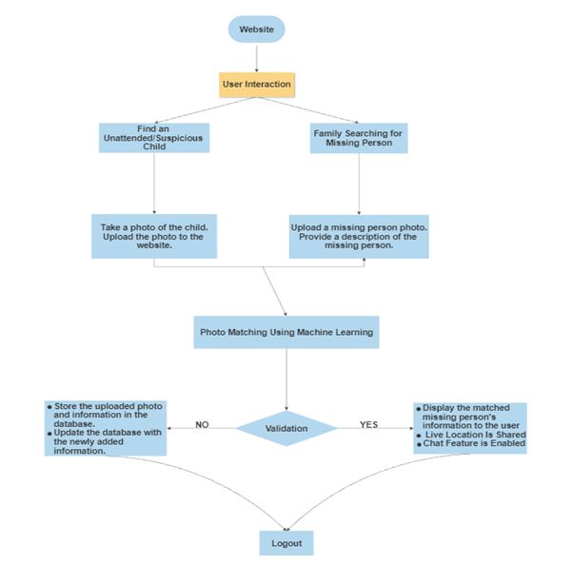
Work Flow

Slide 8
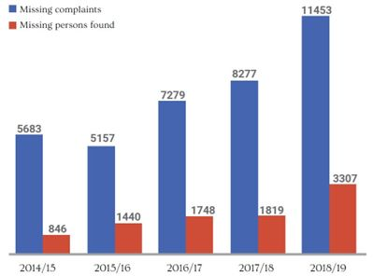
Survey

Slide 9
Future Scope
Machine Learning for Age Progression: Develop a feature that uses machine learning to create age-progressed images of missing children to aid in identification..
We will collab with NGOs and can provide information about volunteer opportunities with organizations that help find missing children.
Language Support: Provide multilingual support to reach a broader audience and ensure that language barriers don't prevent users from reporting or identifying missing children.
The website can provide contact information for law enforcement agencies or other organizations that can assist in locating missing children.
Geofencing Alerts: Allow users to set up geofencing alerts based on their location. If they enter an area where a missing child was last seen, the system can send alerts, encouraging users to be vigilant.

Slide 10
References
https://trackthemissingchild.gov.in/trackchild/index.php
https://www.childlineindia.org/a/issues/missing
https://nhrc.nic.in/sites/default/files/misc_MCRReport.pdf
https://indianexpress.com/about/missing-children/
https://www.tandfonline.com/doi/abs/10.1080/08824091003776289

Slide 11
Thank You

